Slide 1
Goals and A Goal Statement

Slide 2
What am I going to do
Tomorrow?
What have I done today?
Habit of writing Diary?

Slide 3
Dream
As time passes by…....
..Dream..
Dream..
Dream
People Don’t Plan to fail
They Simply fail to plan!

Slide 4
PEOPLE WITHOUT GOALS
HAVE NO DESTINATION!

Slide 5
Create S. M. A. R. T. Goals

Slide 6
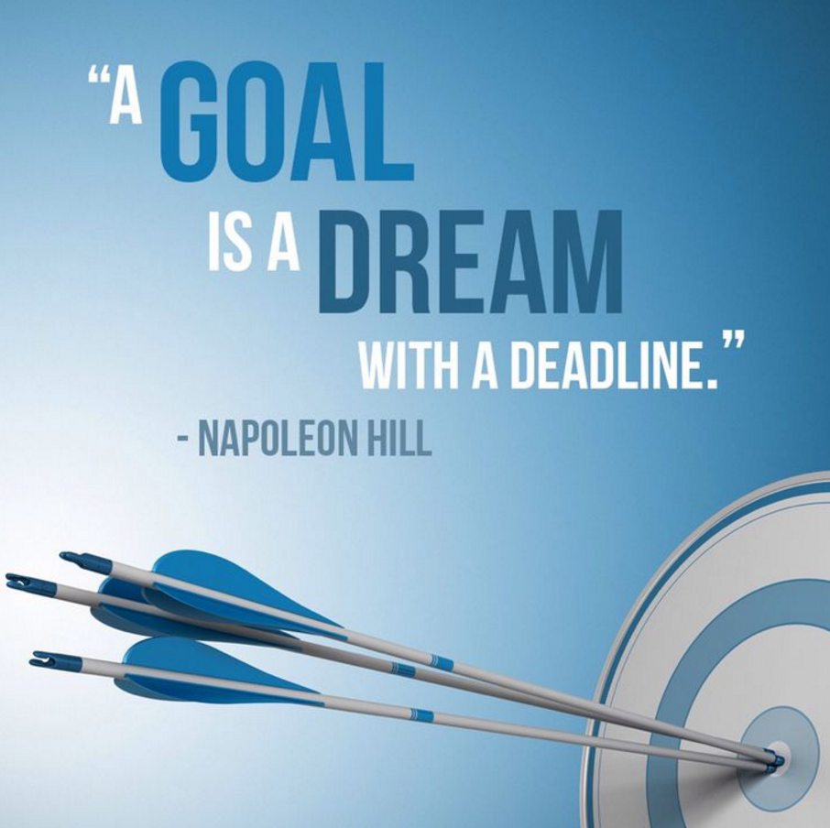
Define Your Dreams
Decide what you want?
… Life, emotional, financial, etc
Define Your Purpose
Why do you set this goal?
Decide when do you want it
Set target date, measure progress & align

Slide 7
Decide What You are Willing to Give Up or Overcome to Obtain Goals

Slide 8
Jessica
Today is 31-Dec-2016, with the laptop on my table, I am happily declare that I am a Professional Coordinator & earning an on-going income of SGD1,875 per week , SGD7,500 per month & SGD97,000 per year. Nothing compare to my previous pay, but most importantly, this is my RESIDUAL INCOME. Hooray!!
Sipping my favorite Riesling with JH, I am now planning to establish my second BDC. My dream now become bigger & my vision become clearer. My ultimate objective is to complete minimum 3 BDCs by 31-Dec-2019.
By then, Jariel has graduated from University and JH can slow down in his travelling. Together with JH, we as a husband & wife team will continue our MASG career to build till we reach 60.
At the age of 60, I’m looking to: (1) travel round the world cruising & enjoying (2) actively involve in the voluntarily work & help the people who needs help (3) write a book & have my own painting.
Write your Goal Statement
50 to 100 Words – Read it twice a day
Add Your “Action Plan”

Slide 9
To build a strong organization that provide you with the financial freedom of SGD97,500 - SGD136,500p.a.

Slide 10
Detailed Plan Break it down to:
Monthly
Yearly divided by 12
Weekly
Monthly divided by 4
Daily
Weekly divided by 5
“If you want things to change…change your Daily Goals”

Slide 11
Weekly Goal
Goal Staircase to S$2,625/week
Talked to 5-15 People
Booked 5 Appointments
Added 10 Possibilities
Daily Steps
5
4
3
2
EVERY DAY STEPS
1
Social Media
Read Goal Statement
Listen to Audio
Talk/call to 1-3 People
Book 1 Appointment
Add 2 Possibilities

Slide 12
Monthly Goal
Goal Staircase to S$2,625/week
Talked to 20-60 People
Booked 20 Appointments
Added 40 Possibilities
Weekly Steps
WEEKLY
GOAL
5
4
WEEKLY
GOAL
3
2
1
Week 4
5
4
WEEKLY
GOAL
3
2
Week 3
1
EACH WEEK
Show Plan 1 time
Follow-Up with 1 Prospect
Attend UBP with guest
Add 1 New Customer
Call Your Coach
5
4
3
2
Week 2
1
5
4
3
2
Week 1
1

Slide 13
ANNUAL GOAL
Goal Staircase to S$2,625/week
Positioned to earn
S$4880/week ongoing income
Monthly Steps
12
11
10
9
8
7
6
Each Month
Show the plan ≥ 4 times
Sponsor 1 (minimum 2 /quarter)
10 Customers ordering ≥ 30 BV and 20 IBV
Attend Monthly Seminar or training
5
4
3
2
1

Slide 14
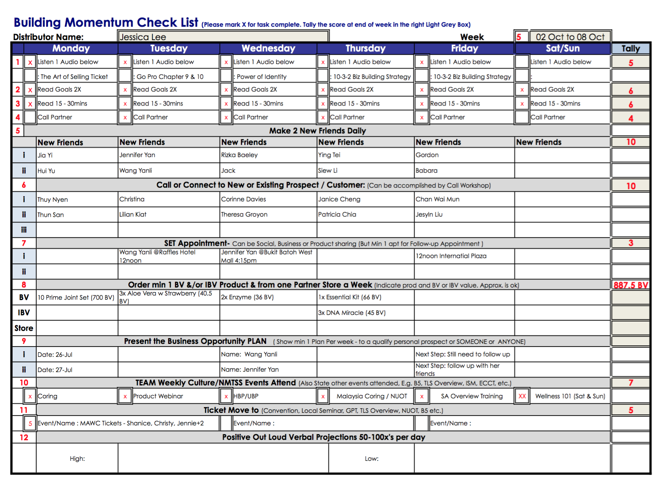

Slide 15
Jessica
Today is 31-Dec-2016, with the laptop on my table, I am happily declare that I am a Professional Coordinator & earning an on-going income of SGD1,875 per week , SGD7,500 per month & SGD97,000 per year. Nothing compare to my previous pay, but most importantly, this is my RESIDUAL INCOME. Hooray!!
Sipping my favorite Riesling with JH, I am now planning to establish my second BDC. My dream now become bigger & my vision become clearer. My ultimate objective is to complete minimum 3 BDCs by 31-Dec-2019.
By then, Jariel has graduated from University and JH can slow down in his travelling. Together with JH, we as a husband & wife team will continue our MS career to build till we reach 60.
At the age of 60, I’m looking to: (1) travel round the world cruising & enjoying (2) actively involve in the voluntarily work & help the people who needs help (3) write a book & have my own painting.
Write your Goal Statement
50 to 100 Words – Read it twice a day
Add Your “Action Plan”

Slide 16
Measure, Monitor, Adjust and Control
Adjust date of completion
Adjust action plan
Attend additional training
Take the Basic 5 Diagnostic quarterly to evaluate progress

Slide 17
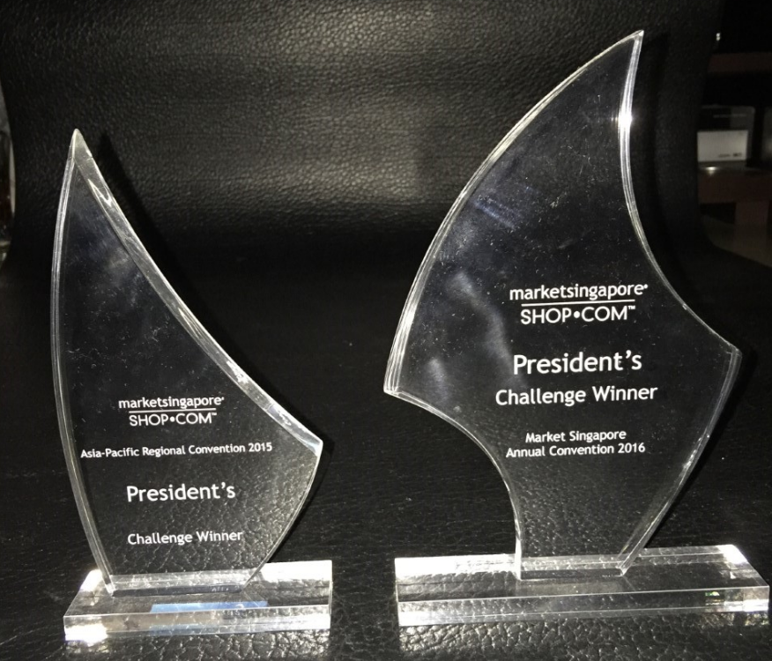
Master unfranchise® owner program
CHAIRMAN’S CHALLENGE

Slide 18
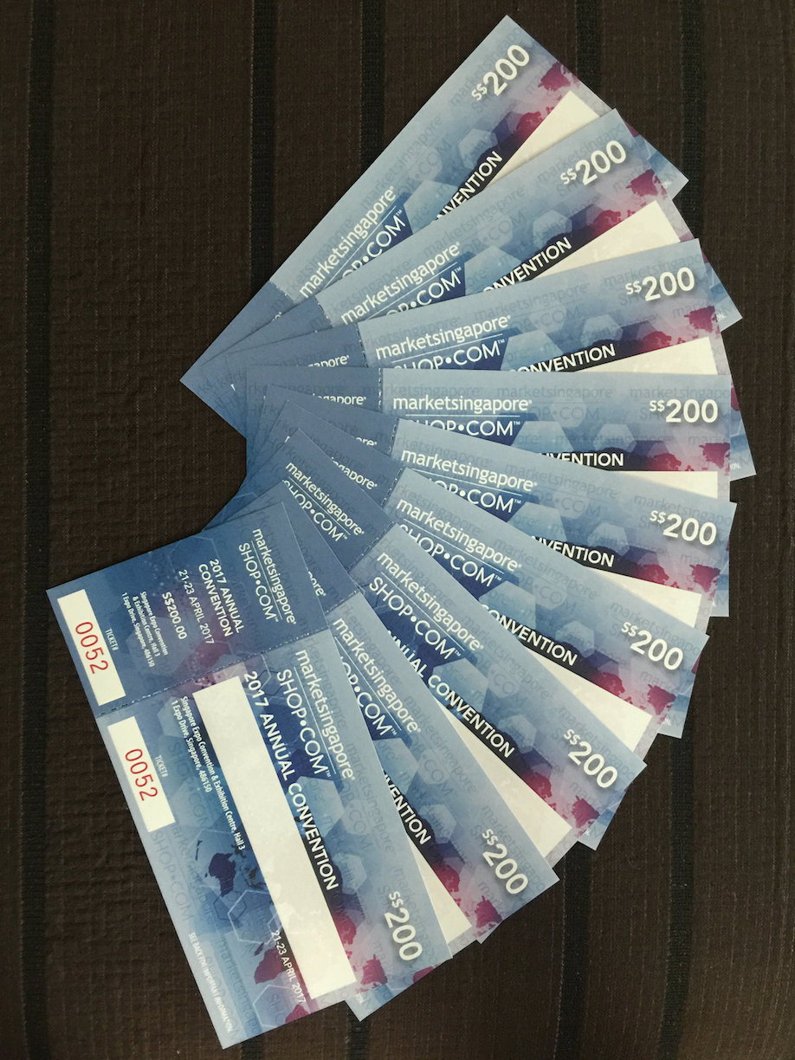
Selling Tickets
(Education)

Slide 19
To Achieve your goals you
must Believe in yourself and take action

Slide 20
Lead by example.
You must succeed so
other people can
realise their dreams.
-JR Ridinger

